Slide 1
Vagrant 101
An Introduction

Slide 2
Overview
Why Vagrant
Terminology
Setup
Demo
Advanced Topics
Resources

Slide 3
What is Vagrant?
VM management tool
Automates the setup of your development environment

Slide 4
Has this happened to you?

Slide 5
New hire
Someone joins your project…
They pick up their laptop…
Then spend the next 1-2 days following instructions on setting up their environment, tools, etc.

Slide 6
Instead, lets do this.

Slide 7
New hire
Someone joins your project…
They pick up their laptop…
Then spend the next 20 minutes running a script which sets their environment up for them.

Slide 8
Other Benefits
Speed of building VMs
VMs become more disposable
"cattle vs pets”
Ability to automate VM customization
Admin rights in “locked down” environments
Versioned history for VagrantFiles
No internet required in some scenarios

Slide 9
My Plan
GFE PC = Vagrant
GFE Mac
Native – Primary
Vagrant - Backup

Slide 10
Ecosystem & Terminology

Slide 11
Vagrant Ecosystem & Expectations
Big
Easy to get stuck down in the weeds
Let’s focus on the basics & “80/20” results
Productive in Vagrant = quick Expert in Vagrant = not quick
Notes:
Multiple ways to make/use all 3 components (VagrantFile, Boxes, & VM Provider)
We’ll save that talk for later on (202 section)

Slide 12
Vagrant Terms
Host The laptop/desktop OS that runs Virtualbox + Vagrant.
Virtual Machine / “VM” / “Guest” The virtual machine OS running within the host.
Vagrant An application that automates the setup of VMs.
VirtualBox An application to run VMs on your Host OS.

Slide 13
Vagrant Terms
Vagrantfile A set of Ruby instructions to Vagrant on how to build and configure a VM. Small Ruby file
Vagrant Box / “Base box” A template for a Virtual Machine. Large file containing the OS
Atlas - online host for pre-built Vagrant Boxes

Slide 14
VagrantFile
VirtualBox App
Vagrant Box

Slide 15
Quick VM Set-up
Prerequisites
Pre-made VagrantFile & Box
Create & Launch the VM

Slide 16
Prerequisites
Virtualbox installed
Vagrant installed
VagrantFile (pre-made for Rails)
Notes:
Both Virtualbox and Vagrant have great, simple installation instructions.

Slide 17
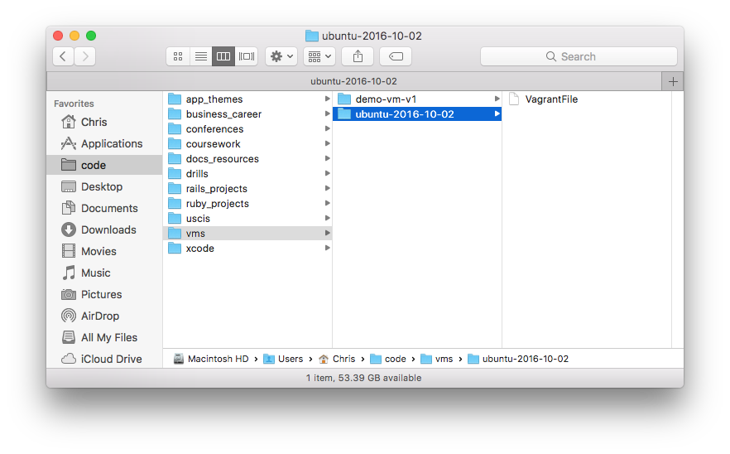
Place VagrantFile inside a working directory

Slide 18
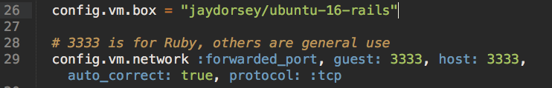
What’s In a VagrantFile?

Slide 19
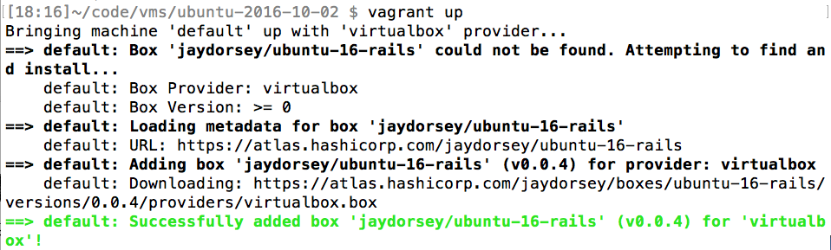
Launch the Vagrant VM
$ cd code/vms/ubuntu-2016-10-02
$ vagrant up

Slide 20
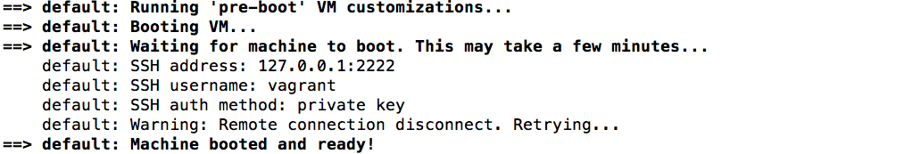
Launch the Vagrant VM
Vagrant VM is ready

Slide 21
This Vagrant Box Includes:
Ubuntu 16.04
Ruby 2.3.1
Postgres 9.6
Git 2.9
Chrome
Sublime Text
other apps...

Slide 22
Using Your New VM
CLI via SSH
GUI via VirtualBox
Shared Folders

Slide 23
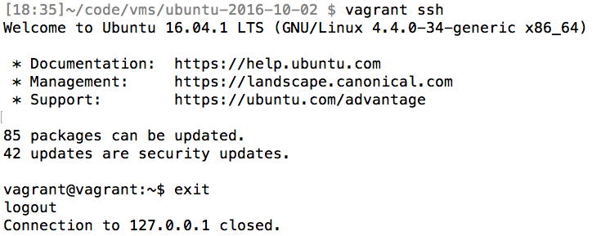
CLI via SSH
$ vagrant ssh

Slide 24
Install Apps
$ sudo apt-get install ...

Slide 25
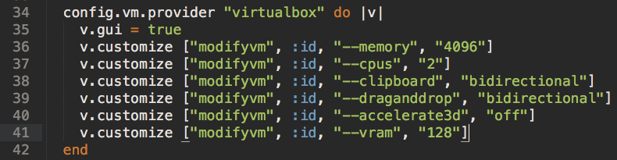
GUI via VirtualBox
Configs in VagrantFile...

Slide 26
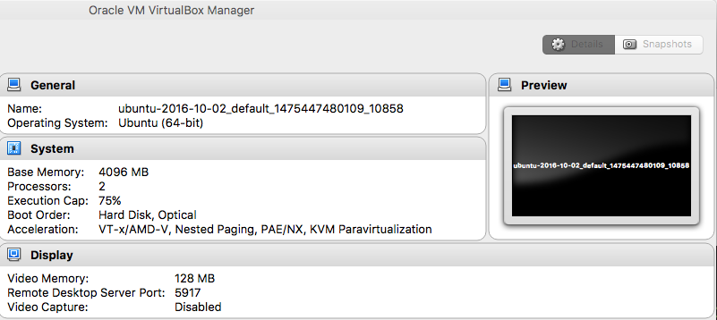
GUI via VirtualBox
...show up in VirtualBox

Slide 27
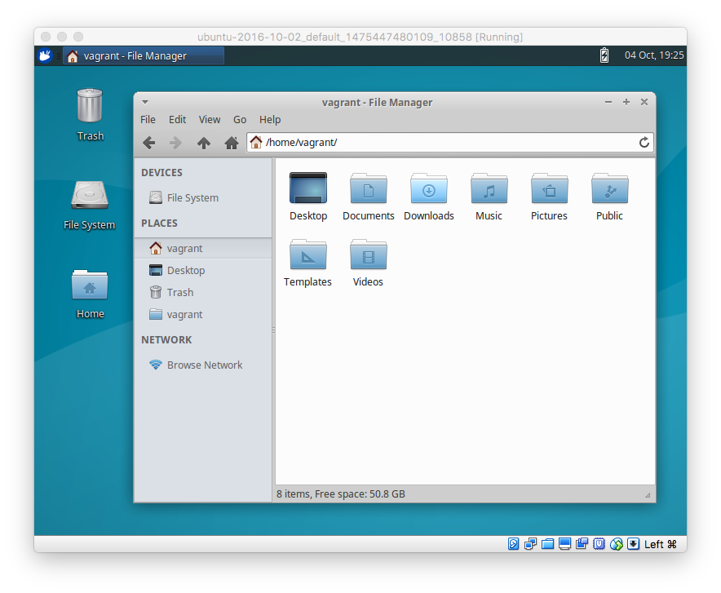
Your New Workstation

Slide 28
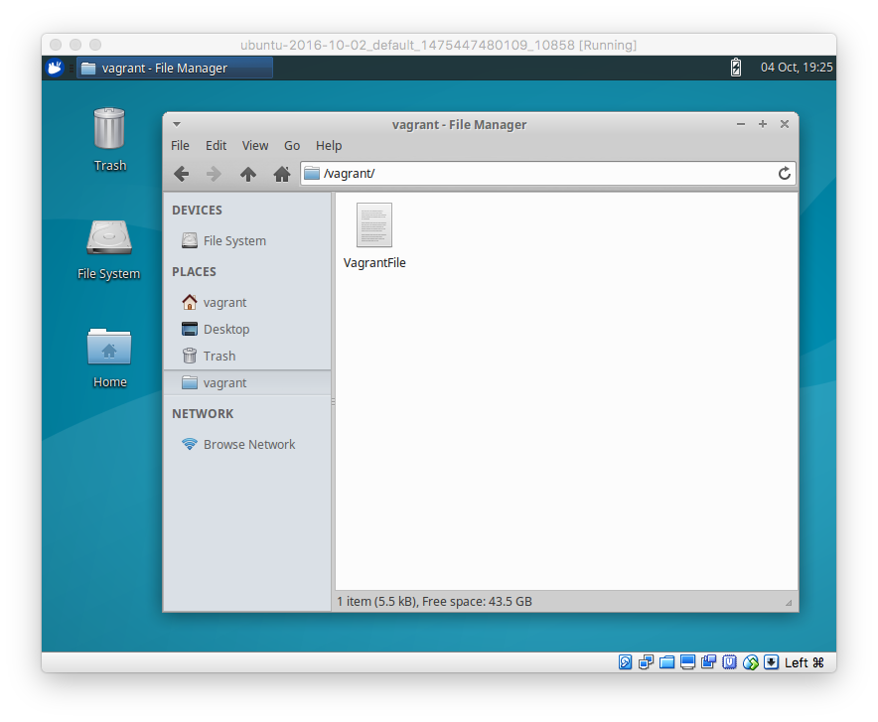
Shared Folders

Slide 29
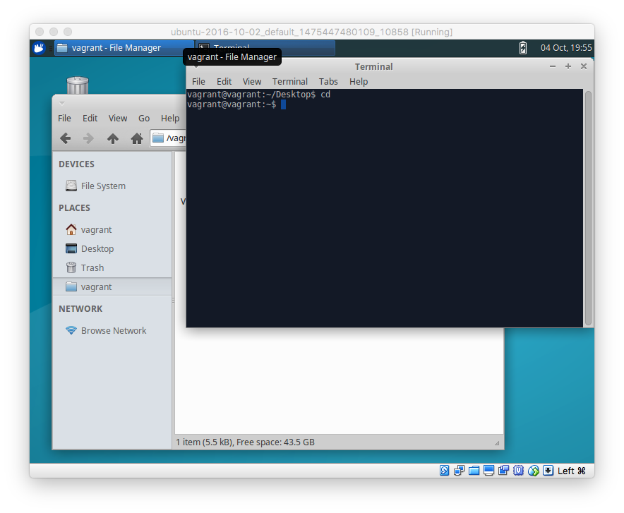
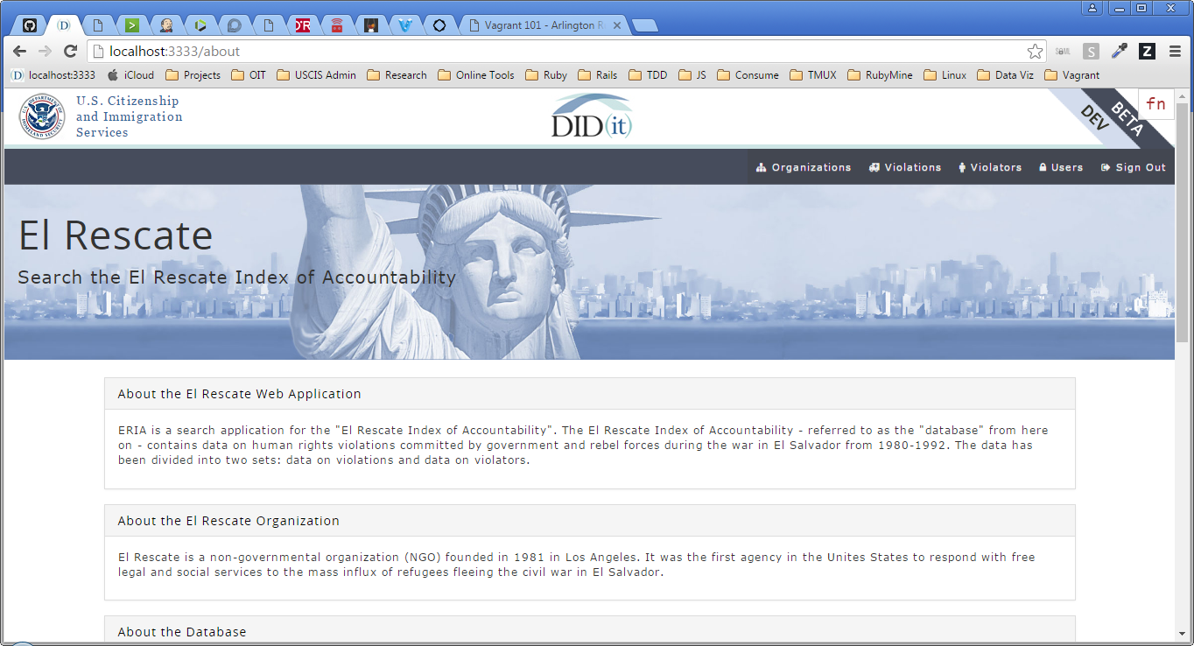
Workaround
Host = Browser
VM = Everything Else
Terminal, Editor, etc.

Slide 30
Stop Your VM

Slide 31
Demo
Notes:
- Vagrant Box List
- Vagrant Up
SSH
ruby, rvm –v
exit
GUI
folder structure
shared folders
Guest Additions – see wiki
“Seamless” mode – Right CNTRL + L
see wiki for auto-login, menubar apps etc
Run ERIA
Browser – Windows
All else – VM
Vagrant Halt (NOT via GUI)

Slide 32
Customization
Choosing a Box
Modifying a Box

Slide 33
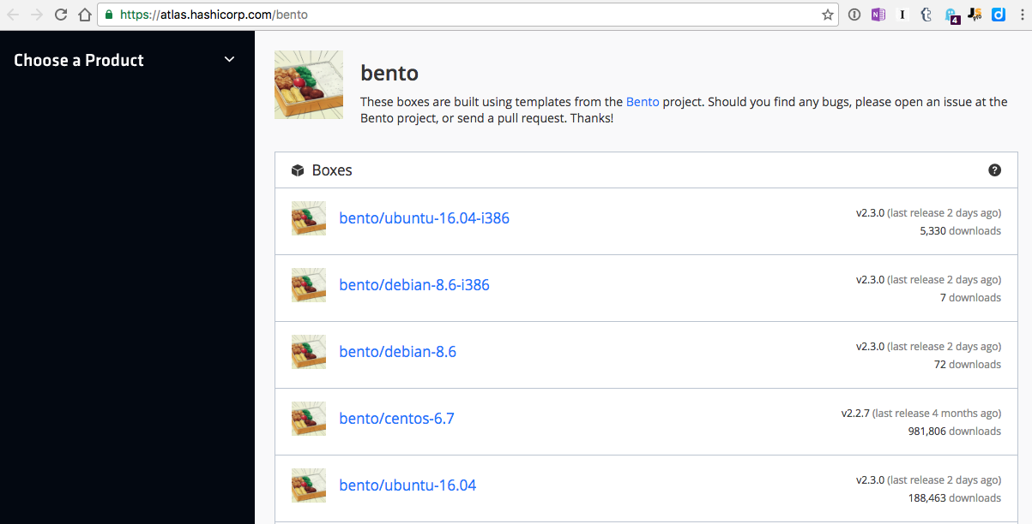
Basic = Bento Boxes (Atlas)

Slide 34
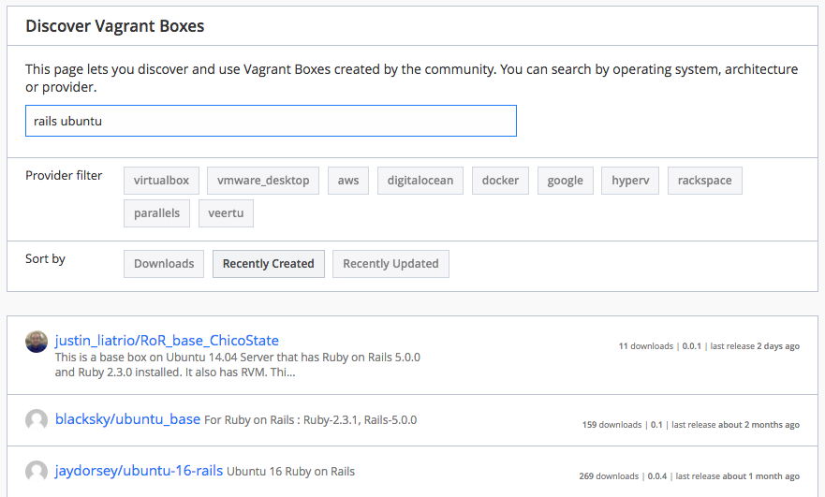
“Pre-Made” = Atlas Search

Slide 35
Modifying Boxes
Manual Changes
Easiest
Repetitive
Can get outdated quickly
Automated Changes
Learning curve (Chef)
Automated
Uses new versions (when built)

Slide 36
Standard practice
Start with a base-box of choice.
Bento boxes recommended
32 bit vs 64 bit
Add a Vagrantfile.
`vagrant init` will give you a blank template
Configure the Vagrantfile.
Hostname, network adapters, config paths…
Add Chef recipes as desired
Kinda like ruby gems
Can use to add RVM, install apps etc.
Great tutorial
https://gorails.com/guides/using-vagrant-for-rails-development

Slide 37
Summary

Slide 38
Vagrant…
Automates the setup and installation of a local dev VM.
Create a fully-configured ready-to-go VM in minutes.
Basic usage doesn't need any new skills.
Advanced configuration possible Chef, Packer etc.
To get started:
Install Vagrant + VirtualBox
Download a “pre-made” VagrantFile
`vagrant up`

Slide 39
FAQ
Docker vs Vagrant?
Complex Question
Docker is for running “containers” (with Apps inside them)
Vagrant is for running full-blown VMs (with guest OS inside them)
Good StackOverflow answer from creators of both apps:
http://stackoverflow.com/questions/16647069/should-i-use-vagrant-or-docker-for-creating-an-isolated-environment
Security of pre-built boxes?
If concerned, pick from Bento boxes or other known boxes
How do I create my own base box?
See “Vagrant 303” slides at end of this deck

Slide 40
Key resources
This presentation - https://github.com/ckib16/vagrant_101
USCIS Wiki - https://git.uscis.dhs.gov/USCIS/didit_onboarding/wiki
Virtualbox - https://www.virtualbox.org/
Vagrant - http://vagrantup.com/
Atlas Box Search - https://atlas.hashicorp.com/boxes/search
Bento Base Boxes - https://atlas.hashicorp.com/bento
Chef resources - http://www.opscode.com/chef/
Tutorial - http://learn.onemonth.com/how-to-setup-vagrant-for-rails
Packer - https://www.packer.io/
Packer + Vagrant Docs
https://atlas.hashicorp.com/help/packer/artifacts/creating-vagrant-boxes

Slide 41
Slide Sources
SIides referenced for this presentation
http://www.slideshare.net/MicheleOrselli/vagrant-for-real
http://www.slideshare.net/manarth/vagrant-crash-course

Slide 42
Thanks!
Chris Kibble
@ckib16

Slide 43
Creating your own Base Box

Slide 44
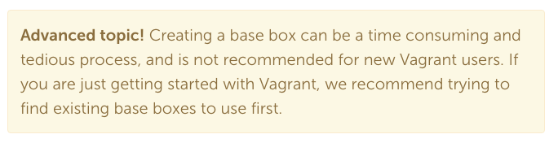
Danger!

Slide 45
Why create a base box?
More flexibility than Chef alone
Trusted source
Specific version of O/S

Slide 46
The Many Paths of Vagrant
Base Box
VagrantFile
Custom VM
Start With...
Modify the...
Result...
Optional `vagrant package`
Custom Base Box
Running VM Itself
Using...
Chef, etc.
Manual Changes
Custom VM
Custom Base Box
Packer Template
Chef, etc.
Custom Base Box
Packer

Slide 47
The Many Paths of Vagrant
Base Box
VagrantFile
Custom VM
Start With...
Modify the...
Result...
Optional `vagrant package`
Custom Base Box
Running VM Itself
Using...
Chef, etc.
Manual Changes
Custom VM
Custom Base Box
Easy
Hard
Packer Template
Chef, etc.
Custom Base Box
Packer

Slide 48
The Many Paths of Vagrant
Base Box
VagrantFile
Custom VM
Start With...
Modify the...
Result...
Optional `vagrant package`
Custom Base Box
Running VM Itself
Using...
Chef, etc.
Manual Changes
Custom VM
Custom Base Box
Easy
Hard
“Real-time” builds. Not “pre-made”
Packer Template
Chef, etc.
Custom Base Box
Packer

Slide 49


Packer & Atlas Intro
Packer – builds Vagrant Boxes
Atlas – hosts Vagrant boxes online (free)
“Creating Vagrant Boxes with Packer”
https://atlas.hashicorp.com/help/packer/artifacts/creating-vagrant-boxes

Slide 50
Box Packaging Tradeoffs
“Real-time” boxes using Chef in VagrantFile
“Pre-made” boxes built with Packer or `vagrant package`
Smaller base-box.
Requires internet access to build.
Always fetches latest version of the packages.
More time – each VM “built from scratch”
Larger base-box.
Ready to go without needing internet access.
Packages may become out-of-date.
Less time – VM is already per-made
Packer is hard to start but probably easiest over long term to manage a box

Slide 51
The Many Paths of Vagrant
Pre-made Base Box
VagrantFile
Custom VM
Custom Base Box
Start With...
Modify the...
Result...
Optional `vagrant package`
Custom Base Box
Running VM Itself
Using...
Chef, etc.
Chef, etc.
Manual Changes
Custom Base VM
Custom Base Box
Packer Template

Slide 52
The Many Paths of Vagrant
Pre-made Base Box
VagrantFile
Custom VM
Packer Template
Custom Base Box
Start With...
Modify the...
Result...
Optional `vagrant package`
Custom Base Box
Running VM Itself
Using...
Chef, etc.
Chef, etc.
Manual Changes
Custom Base VM
Custom Base Box
Easy
Hard

Slide 53
The Many Paths of Vagrant
Pre-made Base Box
VagrantFile
Custom VM
Packer Template
Custom Base Box
Start With...
Modify the...
Result...
Optional `vagrant package`
Custom Base Box
Running VM Itself
Using...
Chef, etc.
Chef, etc.
Manual Changes
Custom Base VM
Custom Base Box
“Real-time” builds. Not “pre-made”
Easy
Hard

